Slide 1



Enhancing mental wellbeing
Five Ways to Wellbeing at work

Slide 2
Karakia
Whakataka te hau ki te uru, Whakataka te hau ki te tonga. Kia mākinakina ki uta, Kia mātaratara ki tai. E hī ake ana te atākura, He tio, he huka, he hauhunga. Haumi e! Hui e! Tāiki e!
Get ready for the westerly and be prepared for the southerly. It will be icy-cold inland, and icy-cold on the shore. May the dawn rise red-tipped on ice, on snow, on frost. Join! Gather! Intertwine!

Slide 3
What we’ll cover today
Understand
mental health and wellbeing
what keeps people and organisations well
Learn
about the Five Ways to Wellbeing
about some practical things that improve wellbeing
anything else?

Slide 4
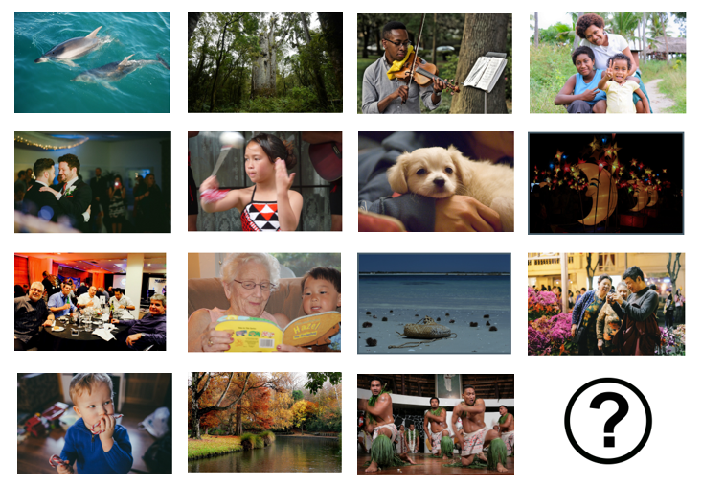
What makes you feel good?

Slide 5
What is mental health and wellbeing?
A state of wellbeing where we can reach our potential, cope with normal stressors, work productively and contribute to community (WHO 2014)
Aspects of work that harm or impair mental wellbeing are commonly referred to as psychosocial risks, but it may be more helpful to refer to psychosocial risks simply as risks to mental wellbeing

Slide 6
Poor mental health
Mental distress (also known as mental illness) is different for everyone
We all have times when we struggle with our mental health
Mental health problems develop when these difficult experiences or feelings go on for a long time and affect our ability to enjoy our lives the way we want to
Some people may have a diagnosis, others may not (or may not agree with it)

Slide 7
Poor mental wellbeing
Costly to both individuals and organisations
Acute or chronic
Result of a single or repeated exposure to risk(s) factors
Impact can be mild to severe psychological disorders, e.g., depression, anxiety

Slide 8
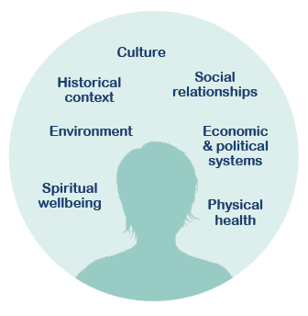
Mental health and mental wellbeing

Slide 9
Resilience model
Individual skills and habits
Supportive environments

Slide 10
Healthy habits of resilient people – Dr. Lucy Hone
Resilient people know that suffering is part of every human existence, a “perfect” life is not the norm
Resilient people are good at identifying what they can change and accepting what they can’t
Resilient people are good at asking “is what I am doing helping or harming me?”
Resilient people are great at finding things to be grateful for

Slide 11
The statistics
It is estimated that mental health problems cost New Zealand businesses at least $1.65bn per annum
The WorkSafe Segmentation and Insights Programme Research (2019) found that in the last 12 months, 20% of respondents experienced depression, 31% anxiety and 60% stress
The New Zealand Workplace Barometer (2020) reported that 70% of respondents reported an absence from work during the last 12 months due to ‘physical or mental health’

Slide 12
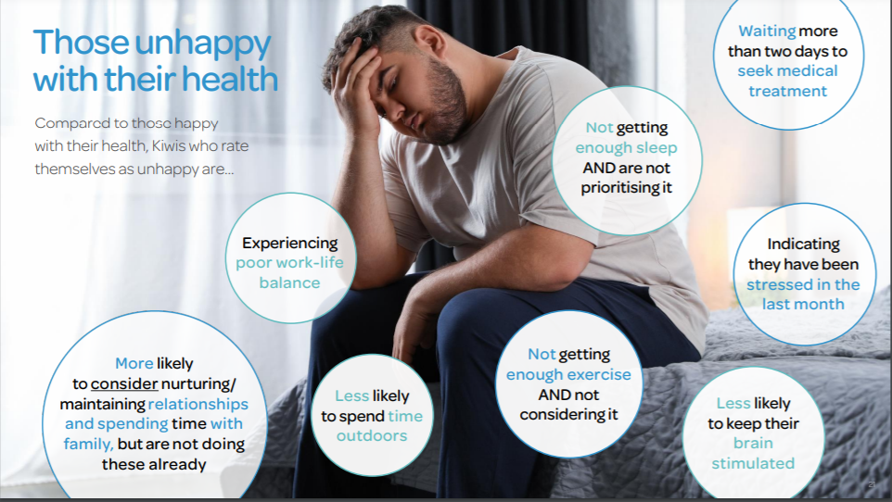
Notes:
Source: Southern Cross Healthy Futures Report 2020

Slide 13
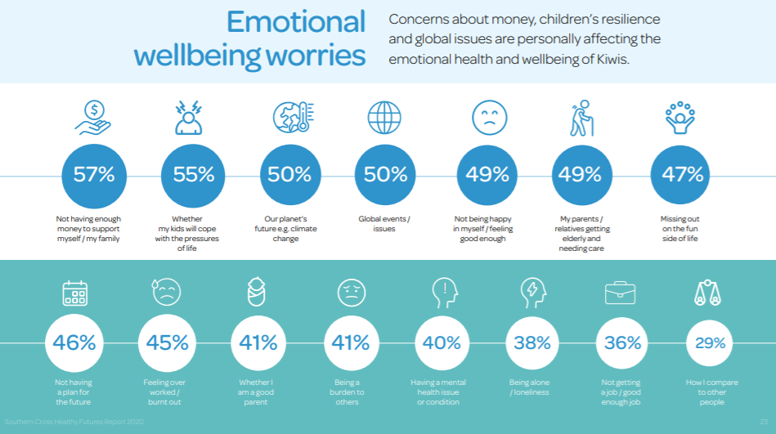

Slide 14
The business case: Te tangata, te tangata
Improved recruitment and retention
Fewer disruptions impacting your organisations
Enhanced reputation
Decreased unplanned leave
Decreased presenteeism
Increased productivity and improved customer service
Knowledge, skills and experience are of little use without energy
HSWA 2015, ERA 2000, Human Rights Act 1993

Slide 15


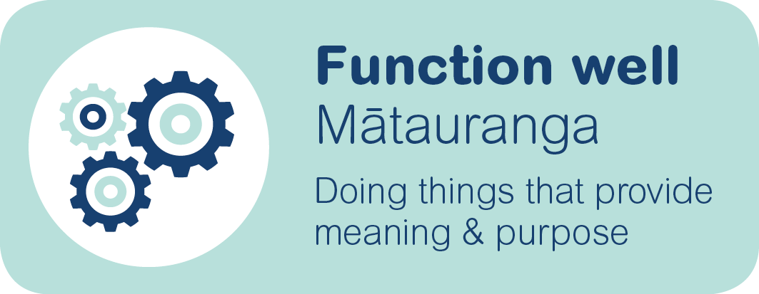
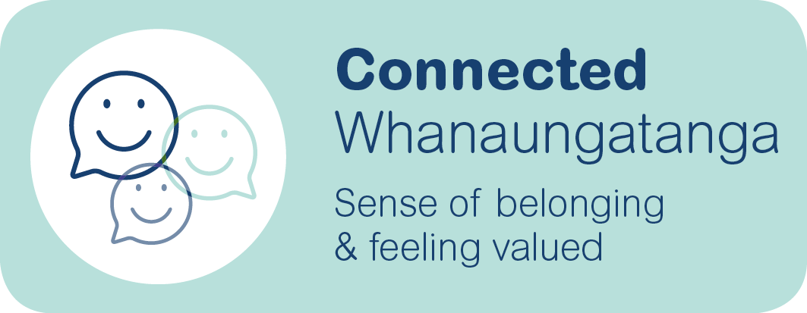
What we want for our workers

Slide 16



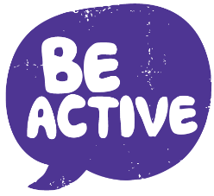

Five Ways to Wellbeing

Slide 17

Strong relationships with others are an essential part of building resilience and boosting wellbeing. They set us up well for when life is tough.
Notes:
How has this changed during your experience of lockdown, and what have you done to help improve the situation for you?

Slide 18
Connection and Covid-19
Staying connected makes us feel safer, and less stressed and anxious
Isolation leads to stress, anxiety and depression
What am I sacrificing?
Act in line with your values, not with what is happening in the moment

Slide 19
Connection and Covid-19 at work
Focus on what is important
WFH – regular “catch ups” both as teams and 1-1
If you can catch up in person safely, then do so
Use a variety of platforms to communicate with others
Building strong relationships when all is going well will help us get through the tough times

Slide 20

Being curious and seeking out new experiences positively stimulates the brain.

Slide 21

Being physically active every day is great for our bodies and minds.

Slide 22

Carrying out acts of kindness, whether small or large, can increase happiness, life satisfaction and our general sense of wellbeing.

Slide 23


Paying more attention to the present moment, to our thoughts and feelings and to the world around us, can boost our wellbeing.

Slide 24
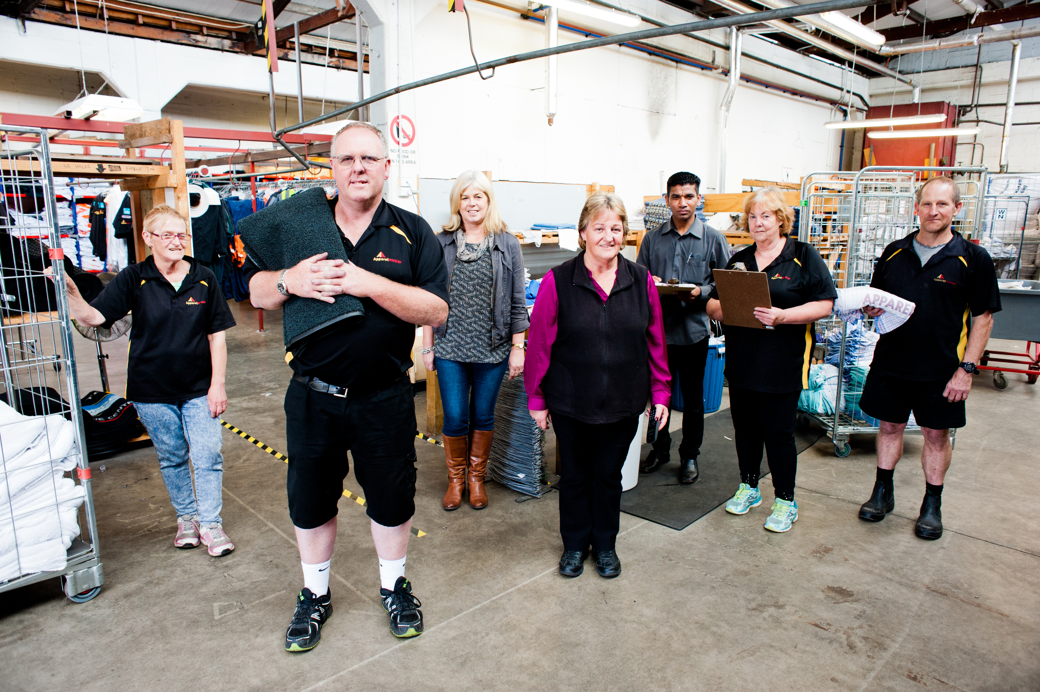
What do you need to have a good day?

Slide 25
Individual wellbeing plan
YOU
Connection
Learning
Be Active
Give
Take Notice
What are you already doing?
What did you used to do, that you have stopped doing?
What would you like to start doing, or do more of?
What would you like to stop doing, or do less of?

Slide 26
Workplace wellbeing plan
TEAM
Connection
Learning
Be Active
Give
Take Notice
What do you already do that supports the Five Ways to Wellbeing?
What would you like to start doing, or do more of?
What would you like to stop doing, or do less of?
What can you control to minimise the negative things or barriers to your wellbeing?
Notes:
What, who, when, why, how

Slide 27
Five Ways – examples
One coffee connection per month
Get together to reflect on achievements
Asking colleagues/friends how they are going
Planned social occasions at work
Talk to each other instead of text/email
Regular check-ins
Ask questions
Share knowledge
Learn a new skill
Encourage teamwork on projects
Allow time for learning
Culture where it is ok to make a mistake
Learn and be curious about other cultures
Take the stairs
Park away from the office and walk
Lunch time walks
Walking/standing meetings
Walk to talk
Standing desks/swiss ball
Social sport
Walk to meetings outside the office
Give a compliment
Make someone else a cup of coffee
Volunteer work
Smile
Compliment
Share food together
Give your time at work to lend a hand
Share what works
Ask someone about their life and wait for an answer
Ask questions
Start a discussion
Check in on yourself – food, exercise, sleep, rest, recovery, Five Ways …
Your environment and others
Body language/tone etc
Perspectives / bias

Slide 28
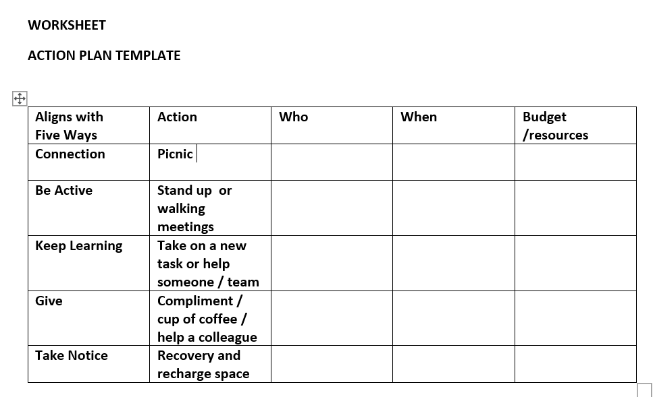

Slide 29
What our workplace offers
Add in your local supports and services, e.g.,
Employee Assistance Programmes
Key staff contacts
Buddy system
Local health and wellbeing providers
Training – leading and managing, courageous conversations, mental health first aid, conflict resolution, other?
You can get an updated list of helplines and local mental health services (https://mentalhealth.org.nz/helplines) - this has space to add your local numbers as well
https://covid19.govt.nz/

Slide 30
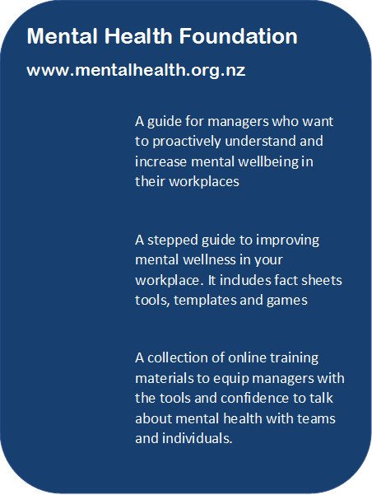

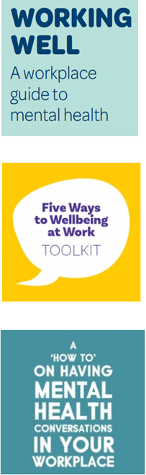
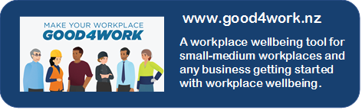



Slide 31
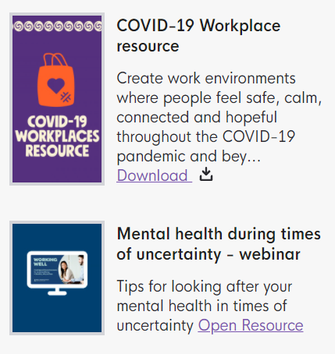
Mental Health Foundation Covid-19 resources
https://mentalhealth.org.nz/search?query=covid

Slide 32
Reviewing workshop goals
Understand
mental health and wellbeing
what keeps people and organisations well
Learn
about the Five Ways to Wellbeing
about some practical things that improve wellbeing

Slide 33
Karakia
Kia whakairia te tapu
Kia wātea ai te ara
Kia turuki whakataha ai
Kia turuki whakataha ai
Haumi e. Hui e. Tāiki e!
Restrictions are moved aside
So the pathway is clear
To return to everyday activities

Slide 34

Enhancing mental wellbeing
Five Ways to Wellbeing at work

